Slide 1

Agile 101 Training

Slide 2
Agenda
Agile frameworks
Scrum Overview
Roles
Events
Artifacts
Creating & managing the agile teams

Slide 3
Agile Frameworks & Scrum Overview

Slide 4
Frameworks & Scrum Overview
Scrum Framework
3 Roles
1. Product Owner
Prioritizes the Product Backlog and represents the business
2. Development Team
Performs the work
Continually improves
3. Scrum Master
Clears roadblocks for the team
Coaches the Scrum practices and mindset
3 Artifacts
1. Product Backlog
What are our priorities?
2. Sprint Backlog
What are we doing now and how will we do it?
3. Increment
What progress have we made in this sprint? In this release?
5 Events
1. Sprint Planning
What is the goal?
2. Daily Scrum
How are we doing toward delivery of the goal?
3. Sprint Review
How did we do? Are we on the right track?
4. Sprint Retrospective
How can we get better?
5. Sprint
The container for all the events
Notes:
Emphasize: Simple framework!

Slide 5
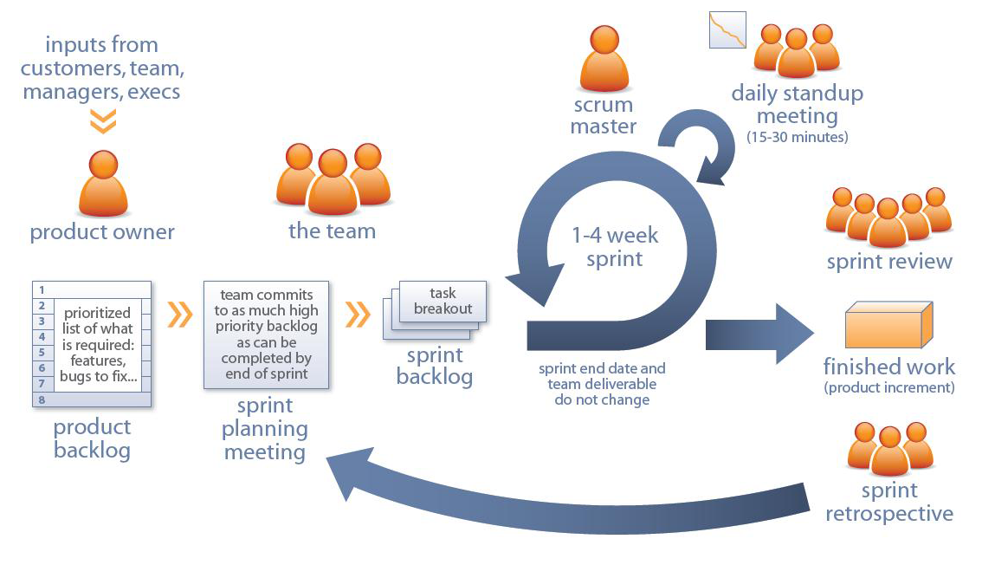
Frameworks & Scrum Overview
Scrum Framework

Slide 6
Scrum Roles

Slide 7






Scrum Roles
1. Product Owner: owns the requirements
2. Scrum Master: owns the Scrum process
3. Development Team: owns the work
Product Owner
Team Member
Team Member
Self-Organizing
not self-managing
Scrum Master
Cross-Functional Team
Analyst
Quality
Notes:
Cross functionally diverse teams should possess all skills needed to complete the work
T-shaped skills: deep skills in a preferred area but can help others when needed
Musketeer means we are all in this together – “one for all, and all for one”
Team over individual, no individual success or failure – succeed or fail as a team - reference penny game
Aristotle said “The whole is greater than the sum of its parts.”

Slide 8




Scrum Roles
Involved vs Committed
INVOLVED
COMMITTED
Product Owner
SMEs
Team Member
Team Member
Management
Scrum Master
Customers
Analyst
Quality
Product Backlog
Cross-Functional Team
Stakeholders
Notes:
The ideas come from the stakeholders and go to the product owner, who prioritizes them onto the product backlog. The product owner identifies the highest priority items and puts them on the backlog in priority ranked order.
The entire team works together to understand the project, discuss the features and break them down into stories.

Slide 9
Scrum Roles
Other Common Roles
Stakeholders
Helps align PO with business strategy
Attends team reviews & provides feedback
Available to answer questions
Executive Leadership
Focuses on vision & strategy
Empowers the team
Removes org impediments
Managers
Optimizes the value stream
Limits resource shifting/multitasking
Provides team with the tools they need
Removes impediments to limiting WIP
Leads
Technical vision and architecture
Consultant & partner for the business
Removes technical impediments
Notes:
Executive Leadership
Creates a compelling vision and strategy
Empowers the team, provides support, and helps to remove impediments
Moves out of tactical day-to-day focus and into a more strategic and process improvement focus
Respects Agile rules
Stakeholders
Customers, Sponsors, Investors
Engages closely with the Product Owner to help define needs, impacts and outcomes
Available to answer questions
Respects Agile rules
Removes impediments
Recognizes team accomplishments
Management
Assigns the right people to the team/product
Limit resource shifting/multitasking
Empowers team through Servant Leadership
Provides team with the tools they need
Challenges status quo by avoiding a “This is the way we’ve always done things” mentality
Collaborates with other managers to break down silos
Continually improves processes by focusing on optimizing the value stream
Leads
If needed, adjust conversation to apply to non-technical environments
Understands business needs and acts as a consultant and partner for the business
Collaborates with others to find simple solutions to meet strategic business needs
Technical Leads: communicates the technical vision and architecture
Supports the developers through execution by coaching and direct involvement
Plans ahead and removes technical impediments

Slide 10
Scrum Events & Artifacts

Slide 11
Scrum Events & Artifacts
Scrum Events – Every event is time boxed
01
Scrum Team determines what work can be delivered
Development Team determines how will the work be achieved
No one can tell the team how to deliver the work ← critical
Sprint Planning
02
Planning meeting
For the Scrum Team (Pigs, but Chickens can attend & answer questions)
Inspect and adapt to meet the sprint goal ← critical
Daily Scrum
03
Product Owner demonstrates working software
Product Owner owns review, but everyone is present & can participate
Stakeholders provide feedback ← critical
Review
04
Most powerful tool available for continuous improvement
Must be a safe environment – Pigs only
Inspect and Adapt ← critical
Retrospective
05
Dev Team is heads down and off limits
Each item is completed “Done”
PO accepts the work ← critical
Sprint
Notes:
Don’t need to deep dive here – they will get this in PSF.
Every event is interactive and requires engagement. Specific inputs and outputs.
Other than the Sprint itself, which is a container for all other events, each event in Scrum is a formal opportunity to inspect and adapt something. These events are specifically designed to enable critical transparency and inspection. Failure to include any of these events results in reduced transparency and is a lost opportunity to inspect and adapt.
Sprint Planning:
Outputs:
Sprint Backlog
Sprint Goal
Commitment to meet the sprint goal
Who
PO, ScrumMaster, Development Team
When
The first day of the sprint
Time boxed (A maximum of eight hours for a one-month Sprint / 4 for 2 weeks)
Daily Scrum
The key to establishing transparency and solid team communication habits. Requires Discipline!
Can't fix problems we don't know about so we expose problems to allow us to improve.
Who
The Scrum Team *PO can be optional sometimes
Used to identify obstacles, not design solutions; no discussion of “how” or side conversations
Scrum Master takes lead to clear obstacles
New tasks get added to Sprint backlog
When
15 minute time boxed event
Same time, same place each day
Every day during the sprint except first and last days
Where
In front of the task board (Sprint Backlog)
Same place every day
Sprint: Scrum Team defines Sprint goal
Development Team self-organizes to complete the work
PO accepts the work throughout the sprint
Results in an increment of potentially shippable software
Time boxed: no more than 4 weeks in length
Review - An event to inspect the Product developed in this sprint and get feedback, and perhaps update the product backlog
Inputs: completed stories
Who:
Scrum Team
Stakeholders
When:
Last day of sprint
Before the Retrospective
Outputs: feedback about the product developed in the sprint
Best Practices:
Only demo “Done” stories - all bugs should be fixed
Best way for team to establish TRUST with the business
Scheduled for the same time, same location
Practice beforehand - strive for a flawless demo
Visual demos - restrict verbal explanations and code/database samples
High attention to detail
Time boxed: 4 week sprint = 4 hours; 2 week sprint = 2 hours
Retrospective- What happens in Vegas…
Input: Feedback from review, team input
Who: Scrum team
When: Typically immediately following the review and before the next sprint
Output:
Track actionable improvements
Focus on the team, not the software
Other:
Occasionally run retrospectives for stakeholders
Time boxed: 4 weeks = 3 hours; 2 weeks = 1.5 hours
Sprint – container for the work to be delivered
Input: Sprint backlog
Who: Scrum Team
When: increment selected by team/org, ongoing, begins with Sprint Planning
Output: deliverable increment of value
One not defined in the scrum guide, must occur but could be different for every team so not mandated is sprint refinement
Input: stories in the backlog
Who: Dev team and PO (and any SME or Stakeholder that might be needed)
When: sometime during the sprint
Output: ready stories

Slide 12
Scrum Events & Artifacts
Scrum Artifacts: Visible and transparent
01
Product Backlog
Scrum’s version of requirements
Ongoing refinement & prioritization
Owned by the PO
02
Sprint Backlog
ALL work items and plan to deliver the goal
Owned by the Development Team
03
Increment
A finished item of value
Notes:
The burndown is not a stated scrum artifact but we use them as visuals.
The Sprint Backlog is a subset of the PBL
1. Product Backlog
Scrum’s version of requirements
Ongoing refinement to maximize emerging needs
Constant prioritization to maximize ROI and focus
Visible and transparent
Owned and managed by the PO
2. Sprint Backlog
Is all work items needed plus the plan to deliver them to meet the Sprint Goal
Can contain user stories, non-functional requirements, and spikes
Visible and transparent
Owned and managed by the Development Team
3. Increment
A finished item of value

Slide 13
Scrum Events & Artifacts
Empiricism – Transparency, Inspection, Adaption
Definition of Done
Any product or system should have a definition of “Done”
“Done” expands as teams mature
Sprint Goal
An objective that will be met within the Sprint
Provides focus and guidance
Notes:
DoD: Any one product or system should have a definition of “Done” that is a standard for any work done on it.
As Scrum Teams mature, it is expected that their definitions of “Done” will expand to include more stringent criteria for higher quality.
Essential for measuring progress and maintaining transparency
Sprint Goal:
After the Development Team forecasts the Product Backlog items it will deliver in the Sprint, the Scrum Team crafts a Sprint Goal.
The Sprint Goal is an objective that will be met within the Sprint
It provides guidance to the Development Team on why it is building the Increment.
Video: Definition of “Done”
https://video.search.yahoo.com/yhs/search;_ylt=A0LEVjeoQWhXE9YAxX8nnIlQ?p=video+definition+of+done&fr=yhs-mozilla-002&fr2=piv-web&hspart=mozilla&hsimp=yhs-002#id=5&vid=74b89ffa2e524e0a73faf93f482b9d3e&action=view

Slide 14



Scrum Events & Artifacts
Communicating Requirements
What executives tend to focus on.
High level objects that provide differentiation or competitive advantages
Themes have a much longer life span than Epics, could span many epics/features, and may remain on the Product Roadmap for 1 year or more.
Example: Mobile Capabilities.
What end users tend to focus on.
Represents multiple features
Can take months to build and works at the release level
Epic
What product owners tend to focus on.
Feature
Smaller than epics, but bigger than stories.
Can take weeks, possibly one or more sprints to build.
Are the smallest increment of value.
Takes 1-2 days, perhaps a week at the most to build.
What developers tend to focus on.
User Story
Notes:
Themes are high level objects that provide differentiation or competitive advantages.
In a Product Roadmap it could be a list of the main areas of focus.
Typically written during Visioning and Portfolio Planning.

Slide 15
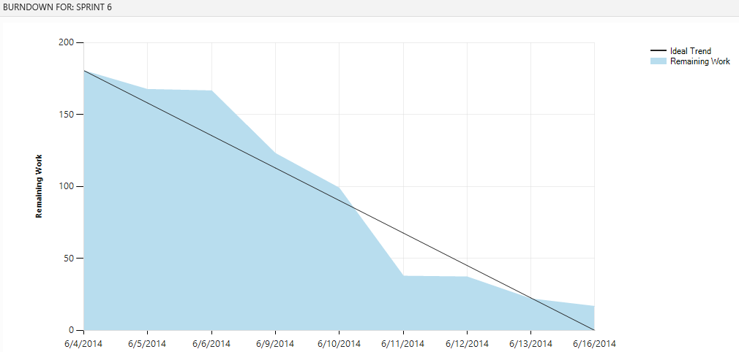
Scrum Events & Artifacts
Communicating Progress – Burndown Chart
Notes:
This shows the progress being made in a sprint by showing work remaining.
Used as a leading indicator to predict when work will be done
The team must keep their remaining work values updated for this to be useful.
This is typically displayed in the team room by the task board.
In scrum there is no specific need to capture actuals. What we care about is understanding how much work remains before we have functioning valuable product.
What do you see?
This is for the team – no one else.

Slide 16
Forming and Managing Agile Teams

Slide 17
Forming and Managing Agile Teams
Team Characteristics
Sized appropriately (3-9)
Focused on the customer: everyone has access to customers
Generalizing Specialists: Not generalists; specialists that are willing to learn and help each other
Self Organized: Team decides HOW the work will be done and WHO will do it
Agile values: Commitment, courage, focus, openness and respect
Notes:
Small – should be fed with 2 pizzas
Self Organizing (not managed)
Consider having a major and a minor – T-Shaped
Values
Successful use of Scrum depends on people becoming more proficient in living the five values.
Commitment to achieving the goals of the Scrum Team.
Courage to do the right thing and work on tough problems.
Everyone focuses on the work of the Sprint and the goals of the Scrum Team.
The Scrum Team and its stakeholders agree to be open about all the work and the challenges with performing the work.
Scrum Team members respect each other to be capable, independent people.
Exercise:
How do we do all this? Through high performing teams!
Take a minute and think of a high performing team that you have witnessed. Visualize what it was like with that team. Share some of these with us. <Trainer write these on white board or easel pad>
Attributes that should come out in discussion:
strong communication – working agreements
focused on a common goal
committed
Discuss Team over Individual
Honesty and transparency

Slide 18
Forming and Managing Agile Teams
Team Norms and Working Agreements
How do we make decisions?
How do we respond to conflicts?
How do we handle impediments?
How do we improve our processes?
How do we manage our work?
How do we communicate with each other?
How do we run our meetings?
How do we help each other have fun?
Notes:
These may seem simple or simplistic but think about it. How many times have you gotten into a situation where if you had just discussed things upfront, drama could have been avoided? It takes practice.
Team norms
Safe environment
Prime Directive: Regardless of what we discover, we understand and truly believe that everyone did the best job they could, given what they knew at the time, their skills and abilities, the resources available, and the situation at hand.
Used in Retrospectives at the beginning to set the tone and remind everyone. Really is a good thing to remember all the time.
Dedicated work space (real or virtual)

Slide 19
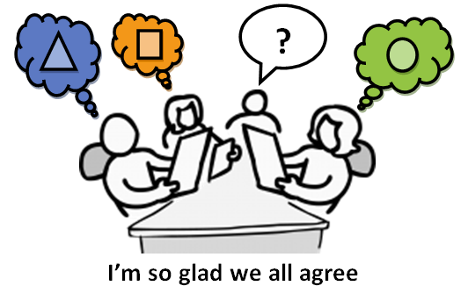
Forming and Managing Agile Teams
Shared Understanding and Vision
All team members should understand product vision and customer needs
All events performed as a team
Writing Stories
Estimating Stories
Determining Acceptance Criteria
Planning a Sprint
Reviewing a Sprint
Reduces friction and rework

